Slide 1

Relative Energy Deficiency Syndrome in Sport (RED-S)
The under-fueled athlete hiding in plain sight
Dr. Vanessa Lalley-Demong Dr. Ahmed Almafrachi Dr. Olivia Bielak
01
Notes:
Opening: REDs is not simply an eating disorder talk. It is a performance, injury, and medical safety talk. We will keep it practical for the people who see athletes first: coaches, athletic trainers, and physical therapists.,Use RED-S if the audience knows it; mention that IOC 2023 uses REDs for clearer language.

Slide 2
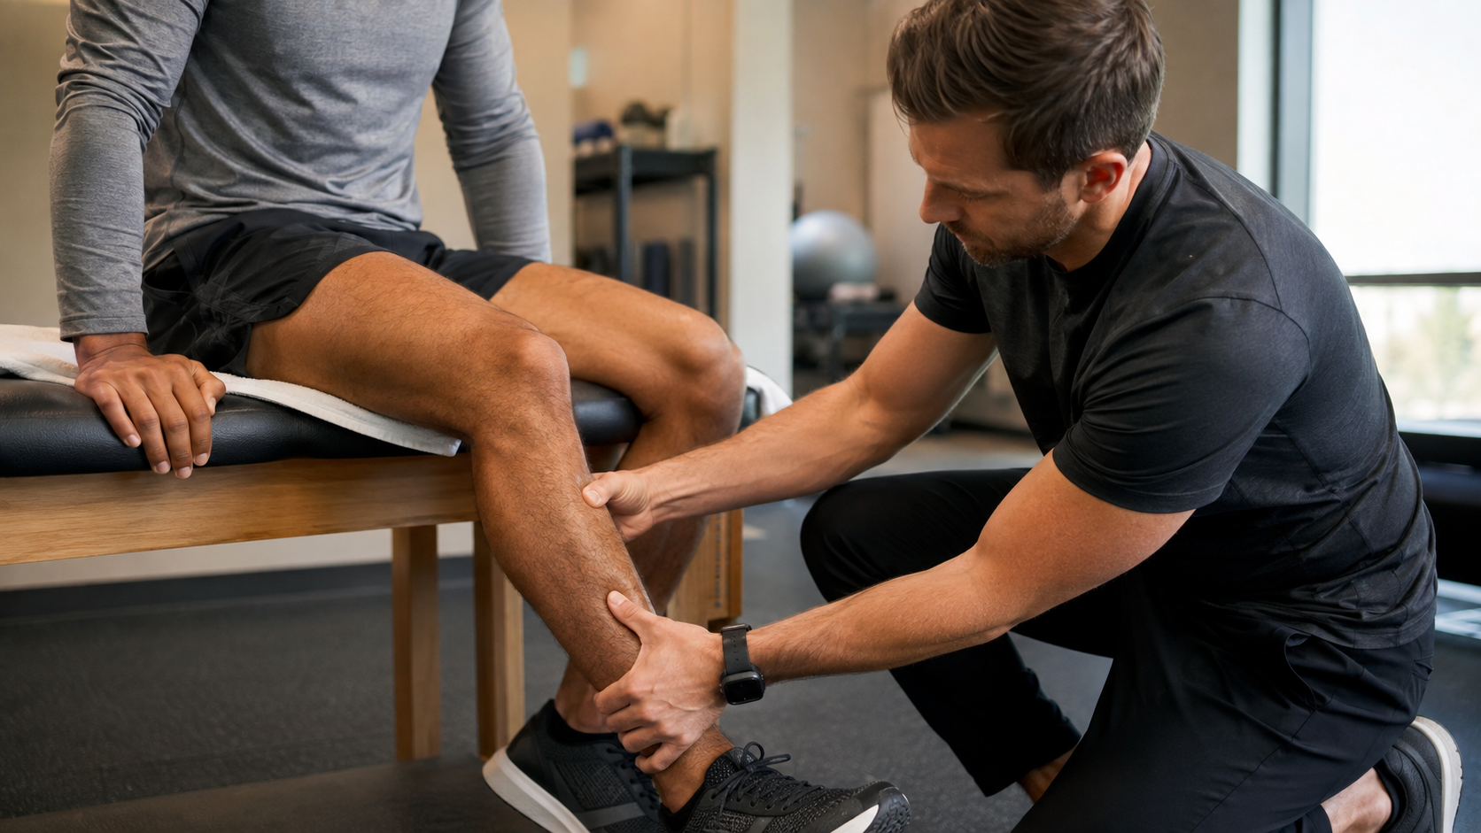
The athlete who is training harder... and getting worse
Start with the pattern, not the diagnosis.
20-year-old runner
Mileage jumps 50 -> 72 miles/week
Performance falls
Race times slow despite more work
Shin pain + fatigue
“Heavy legs” even after rest days
Question: injury problem or fueling problem?
02
Notes:
Tell the audience this is the case they will solve. Ask: If you are the coach or AT, what do you think first: shin splints, overtraining, iron deficiency, poor sleep, or something bigger?,The point is that REDs often enters through the side door: performance decline, repeated injury, exhaustion, or mood changes.

Slide 3
Roadmap
1. Recognize
2. Screen
3. Act
Spot early REDs patterns before a stress fracture or collapse forces the issue.
Know what to ask, what to measure, and what tools can and cannot prove.
Use a shared traffic-light plan to refer, restrict, fuel, and return safely.
03
Notes:
Set expectations: this is a practical talk. We will avoid turning the audience into endocrinologists. But we will give them enough evidence-based language to know when to escalate and how to explain the why.

Slide 4

REDs is what happens when training demands repeatedly exceed the energy left for normal body function.
It can affect females, males, adolescents, adults, para-athletes, endurance athletes, weight-class athletes, and team-sport athletes.
Not “just the female athlete triad”
Not always intentional
Not always obvious by body size
DEFINITION
04
Notes:
Definition from IOC 2023: REDs is impaired physiological and/or psychological functioning caused by problematic low energy availability. The practical language: the athlete is spending too much energy on training and leaving too little for repair, hormone signaling, immunity, bone, heart, blood, and brain.,Important: REDs can occur with or without a formal eating disorder. Many athletes simply under-fuel unintentionally when training volume increases.

Slide 5
Low Energy Availability: the math behind the syndrome
The body does not care whether the deficit was intentional.
Energy in
-
Exercise cost
=
Energy left for life
/ kg fat-free mass
problematic LEA
borderline
adequate / resilient
Old useful number
Better 2023 message
Performance language
<30 kcal/kg FFM/day often signals risk in research settings.
There is no universal cutoff; risk is clinical and cumulative.
Fuel is not a reward. Fuel is part of training.
FFM = fat-free mass. Field decision-making should not rely on calorie math alone.
05
Notes:
Explain formula: EA = (Energy Intake - Exercise Energy Expenditure) / fat-free mass. This is research math, not something coaches can precisely calculate on the sideline.,The old <30 number is useful to explain the concept, but IOC 2023 emphasizes adaptable versus problematic LEA rather than a universal cutoff. In practice, repeated symptoms, injuries, and objective findings matter more than one calorie estimate.

Slide 6
When the “tank” stays low, the body starts making trade-offs
It preserves survival. It sacrifices performance and repair.
H
C
Hormones
LOW
ENERGY
AVAILABLE
Cardio / blood
B
P
I
M
Bone
Performance
Immunity
Mood / sleep
PHYSIOLOGY
06
Notes:
This slide is the core physiology in plain English. With prolonged or severe LEA, the body shifts energy away from reproduction, bone formation, immune defense, muscle repair, thyroid/metabolic activity, and psychological well-being.,For ortho: bone is a major endpoint, but REDs is not only bone. For coaches: performance declines are not laziness. They are often biology.

Slide 7
From “Female Athlete Triad” to REDs: wider lens, same fuel problem
Do not miss the athlete because they do not fit the old stereotype.
Triad lens
REDs lens
Female athletes
Energy availability
Menstrual function
Bone mineral density
All genders
All levels: recreational to elite
More systems: endocrine, bone, immune, metabolic, cardiovascular, mental health
Performance and health model
expanded to
Keep the triad in your brain. Use REDs at the sideline.
EVOLUTION
07
Notes:
The Female Athlete Triad remains clinically important, especially in menstruating athletes and bone stress injury risk. REDs expands the model to male athletes, para-athletes, team sports, and multiple body systems.,Make this practical: if you only screen young female distance runners, you will miss male wrestlers, male runners, cyclists, gymnasts, dancers, rowers, soccer players, and para-athletes.

Slide 8
Red flags in the training room
You rarely get one perfect clue. You get a pattern.
Injury pattern: Stress reactions/fractures, recurrent tendinopathy, slow healing
Performance pattern: Unexplained drop in pace, power, VO2, training tolerance
Recovery pattern: Chronic fatigue, poor sleep, soreness that never clears
Vital/sign pattern: Cold intolerance, bradycardia, dizziness, low BP
Illness pattern: Frequent URIs, missed training blocks
Behavior pattern: Rigid eating, fear of rest, hiding weight loss
Rule: one stress fracture is a nutrition question until proven otherwise.
08
Notes:
Make this slide interactive. Ask athletic trainers and PTs: which of these do you already see every week? The key is not to over-diagnose from one symptom. It is to recognize clusters and trends.,For orthopedic surgeons: bone stress injury should trigger screening for LEA/REDs, especially if recurrent, high-risk site, delayed healing, or paired with fatigue/performance decline.

Slide 9
The 90-second conversation that finds the hidden athlete
Use performance language first. It lowers defensiveness.
Training
Female athletes
“What changed in your training load recently?”
“Any missed or changed periods?”
Fuel
Male athletes
“Do you feel like you eat enough on hard days?”
“Any drop in libido or morning erections?”
Recovery
Safety
“Do you wake up recovered or already drained?”
“Dizziness, fainting, chest pain, purging, or thoughts of self-harm?”
Body pressure
“Has anyone suggested changing weight, size, or body composition?”
Ask privately. Ask without blame. Document the pattern.
SCREEN
09
Notes:
Coaches do not need to diagnose. They need a script that opens the door. The best opening is often performance and recovery, not weight.,Do not ask sensitive questions in front of teammates. Avoid shaming. If there are safety symptoms such as syncope, chest pain, purging, severe restriction, suicidal ideation, or severe bradycardia, escalate urgently.

Slide 10
Who is high risk? More athletes than you think.
The risk is the mismatch: training load, intake, pressure, and recovery.
Endurance
Weight-class
Aesthetic
distance running
cycling
triathlon
wrestling
rowing
combat sports
gymnastics
dance
figure skating
Team sports
Male athletes
Para-athletes
soccer
basketball
lacrosse
low testosterone
libido changes
recurrent BSI
unique energy cost
body composition
access barriers
Body size is not a screening tool. A healthy-looking athlete can be in severe physiologic trouble.
RISK GROUPS
10
Notes:
REDs is not limited to thin appearing athletes. Some athletes have normal or higher body weight and still have low energy availability relative to training load. Para-athletes deserve special attention because energy expenditure, body composition assessment, and access to sport nutrition may differ.

Slide 11
Screening tools: useful flags, not final answers
Questionnaires help you find risk; clinicians diagnose the syndrome.
PPE add-ons
LEAF-Q
EDE-Q / BEDA-Q
CAT2
Annual screen: injury history, fueling, menstrual history, weight pressure, mood, sleep.
Validated mainly for female endurance/dance contexts; not a universal sport tool.
Finds eating-disorder risk patterns; needs confidential medical follow-up.
Risk stratification and sport participation guidance led by a physician.
Positive screen = start a conversation + collect objective data + refer.
Negative screen does not rule out REDs if the clinical pattern is strong.
Objective trends: weight trajectory, resting HR/BP, injury record, training load, menstrual pattern, labs/imaging when indicated.
TOOLS
11
Notes:
Evidence update: Screening tools are helpful but imperfect. LEAF-Q can be helpful in validated populations, but studies show limitations in female football and other populations. The IOC CAT2 is not a sideline questionnaire; it is a medical risk stratification tool.,Make clear: the audience should not use a questionnaire to clear or restrict a serious athlete alone. Use it to justify referral and documentation.

Slide 12
IOC REDs CAT2: the traffic-light language everyone can understand
Four lights. Four levels of sport participation risk.
GREEN
YELLOW
ORANGE
RED
1
2
3
4
Healthy / low risk
Mild risk
Moderate-to-high risk
High clinical risk
Full training and competition
Routine monitoring
Participate with education
Monitor trends
Modify training
Treatment contract
Frequent reassessment
Consider removal
Medical stabilization
No “push through”
CAT2 is not a punishment tool. It makes risk visible and protects the athlete and the team.
CAT2
12
Notes:
Important correction from many older slides: 2023 IOC REDs CAT2 uses four colors: green, yellow, orange, and red. Yellow is not the whole middle anymore. Orange captures athletes who are not necessarily medical emergencies but cannot safely train normally.,Say: The traffic light gives a shared language. It helps the physician, AT, PT, RD, coach, and athlete stop arguing from opinions and start acting from risk.

Slide 13
Differential diagnosis for REDs-like presentations
Fatigue/performance drop
iron deficiency, sleep disorder, depression/anxiety, viral illness, overtraining, thyroid disease
Amenorrhea
pregnancy, PCOS, thyroid/prolactin disease, primary ovarian insufficiency, medications
Low testosterone
primary/secondary hypogonadism, medications, sleep deprivation, pituitary disease
Bone stress injury
training error, vitamin D deficiency, low BMD, biomechanics, metabolic bone disease
Bradycardia/dizziness
conditioning, dehydration, arrhythmia, eating disorder, medications
BACKUP
22
Notes:
Backup slide. Emphasize that REDs requires ruling out alternative explanations and comorbid contributors. Do not prematurely attribute everything to under-fueling.

Slide 14
Medical workup: REDs is a diagnosis of pattern + exclusion
Do not blame fueling before ruling out dangerous mimics.
History + exam
Common labs
Endocrine/bone
Vitals, orthostatics, growth/puberty, menstrual or libido history, injury timeline, eating behaviors, medications.
CBC, CMP, ferritin/iron, TSH/free T4/T3 when indicated, vitamin D, pregnancy test if relevant.
Estradiol/LH/FSH or testosterone, prolactin when indicated, DXA for BMD risk, MRI for suspected BSI.
Do not miss
Red flags for urgent care
Ortho lens
Eating disorder, thyroid disease, anemia, diabetes, pregnancy, inflammatory disease, infection, malignancy.
Syncope, chest pain, severe bradycardia, electrolyte concerns, purging, suicidal ideation.
Recurrent or high-risk bone stress injury = screen for REDs and metabolic bone risk.
13
Notes:
This is the physician slide. Emphasize that REDs is a clinical diagnosis requiring differential diagnosis. Not every tired athlete has REDs. But once the pattern is present, medical evaluation should be timely.,For the audience: you are not ordering all of these tests. You are recognizing when an athlete needs a sports physician or primary care clinician comfortable with REDs.

Slide 15
What to do tomorrow when you suspect REDs
A practical first-response plan for non-physicians.
1
Protect privacy
Do not discuss weight or menstrual/libido details in front of teammates.
2
Document pattern
Training load, injury history, fatigue, weight trend, vitals, performance drop.
3
Reduce risk
Stop impact if bone stress injury suspected; avoid “just push through.”
4
Refer early
Sports physician + registered sports dietitian + mental health support if needed.
5
Control the message
Fueling is training. Restriction is risk management, not punishment.
Never promise secrecy if the athlete may be medically unsafe.
ACTION
14
Notes:
Give a stepwise action plan. Most audience members are not diagnosing or prescribing. They are protecting the athlete, documenting risk, reducing immediate exposure, and connecting the right team.,If bone stress injury is possible, do not increase training while waiting. If there are urgent medical or psychiatric signs, escalate immediately.

Slide 16

Treatment is not “eat more and come back next week”
It is coordinated energy restoration with medical risk management.
Sports physician
medical lead, differential diagnosis, clearance decisions
Registered sports dietitian
energy availability, meal timing, carbohydrate availability
Mental health professional
body image, anxiety, eating disorder care when present
AT / PT / coach
daily load, symptoms, communication, safe progression
Do not use oral contraceptives simply to “bring back” a period; it can mask ongoing low energy and bone risk.
TREATMENT
15
Notes:
Treatment is multidisciplinary. The most important intervention is correction of low energy availability, often through increased intake, reduced exercise expenditure, or both. A dietitian handles nutrition specifics; a physician handles medical clearance; mental health professionals handle eating disorder risk, anxiety, depression, and body image concerns.,For menstruating athletes: hormonal contraception can produce withdrawal bleeding but does not prove recovery of the hypothalamic-pituitary-ovarian axis and may mask ongoing bone risk.

Slide 17
Return-to-sport is criteria-based, not calendar-based
The athlete earns load back by demonstrating physiologic recovery.
1
2
3
4
5
6
Stabilize
Fuel
Repair
Load
Sport
Compete
vitals safe
no urgent medical risk
consistent intake
weight/energy trend stable
bone pain controlled
imaging plan if BSI
low-impact cross-training
rest days protected
progressive sport-specific drills
no symptom rebound
clearance + monitoring
team communication
Backslide rule: symptoms, weight loss, vitals worsening, or pain recurrence = step down and reassess.
RETURN TO SPORT
16
Notes:
A strong return-to-sport slide should sound like a clearance plan, not a recipe. Criteria include medical stability, consistent fueling, resolution/improvement of symptoms, injury healing, and no rebound during gradual load.,For the runner case, return starts with non-impact cross-training and proceeds to running only after medical criteria are improving.

Slide 18
Case reveal: the “stagnant” runner
Now the pattern becomes hard to ignore.
MRI
Grade 3 posteromedial tibial stress fracture
What is his CAT2 risk?
Vitals
Green
Yellow
Orange
Red
Resting heart rate 38 bpm
Labs
Total testosterone 180 ng/dL; low free T3
Context
High-school eating habits + nearly doubled college training load
CASE
17
Notes:
The purpose of this case is to apply the framework. Most clinicians would treat this as at least orange and possibly red depending on the full CAT2 scoring and medical stability, because he has active bone stress injury, bradycardia, suppressed sex hormones, suppressed thyroid marker, fatigue, and performance decline.,Let the audience vote. Then explain that the point is not to name a color perfectly from limited data; the point is that full training is not appropriate.

Slide 19
Case action plan: defend the athlete, not the mileage
This is where the team either protects him or loses him.
Immediate restriction
Physician evaluation
Sports RD plan
No running/impact while bone stress injury and high-risk physiology are addressed.
Assess medical stability, differential diagnosis, labs, imaging, and CAT2 risk.
Increase total energy and carbohydrate timing around workouts; reduce deficit.
Low-risk movement
Clearance criteria
Pool running, cycling, strength/rehab only if symptoms and medical status allow.
Pain-free progression, stable vitals/weight, improving labs, team agreement.
Winning the week is not worth losing the athlete for the season.
CASE
18
Notes:
Explain the emotional pressure. The coach wants mileage. The athlete wants to compete. The AT/PT may feel caught in the middle. This is where CAT2 and objective data help justify removal or modification.,A return plan must be coordinated. It is not enough for shin pain to feel better if energy availability and physiology remain abnormal.

Slide 20

Prevention is a team culture problem
Athletes fuel better when adults stop sending mixed messages.
Stop public weigh-ins
Private, clinically justified body composition only.
Plan fueling around practice
Carbohydrate availability is not optional on hard days.
Normalize reporting symptoms
Fatigue, missed periods, libido changes, dizziness, injuries.
Protect return-to-play decisions
Medical clearance cannot be overruled by a schedule.
19
Notes:
REDs prevention is not a single lecture once a year. It is daily culture. The strongest prevention targets are unsafe weight practices, inadequate fueling access, stigma around menstrual and male hormonal symptoms, and pressure to train through warning signs.,Coaches have a huge positive role when they frame fueling as training and make medical reporting safe.

Slide 21
The takeaway: screen early, refer early, return slowly
The athlete who looks tough may be running on empty.
1
REDs is a fuel-availability syndrome, not a body-size diagnosis.
The best REDs care is boring:
2
Performance decline + recurrent injury should trigger screening.
you notice early,
you ask kindly,
you refer fast,
and the athlete never reaches crisis.
3
Questionnaires are flags; CAT2 helps risk-stratify.
4
Treatment requires a team: physician, sports RD, mental health, AT/PT/coach.
5
Return is criteria-based: stable physiology first, sport load second.
20
Notes:
Use this as a strong ending before Q&A. Summarize the talk: screen early, do not rely on appearance, use current CAT2 language, do not diagnose from questionnaires alone, and protect the athlete with criteria-based return.

Slide 22
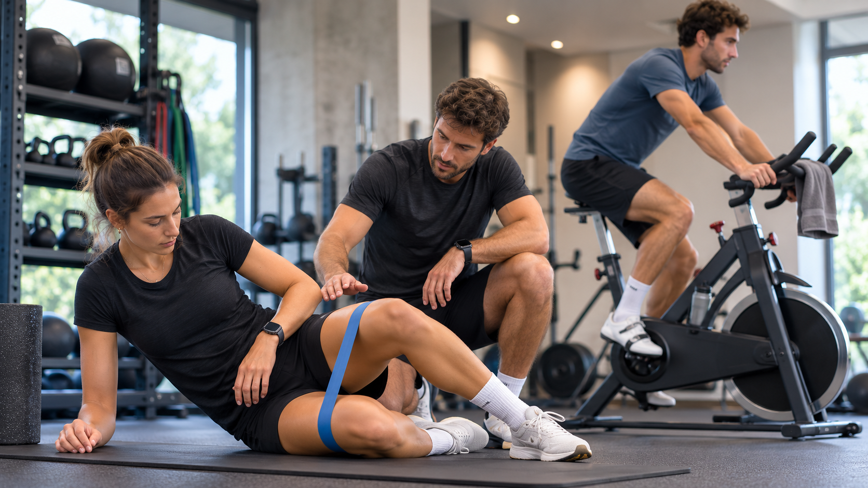
Questions & Discussion
Q&A
21
Notes:
Prepare for Q&A using these cases. Keep answers practical: if risk is significant, full competition should wait. If an athlete looks normal, you still respect objective signs. If a questionnaire is negative, you still act on concerning patterns.

Slide 23
Key references
Core evidence used to update and rebuild this talk.
Mountjoy M, et al. 2023 IOC consensus statement on REDs. British Journal of Sports Medicine. 2023;57:1073-1097.
Stellingwerff T, et al. IOC REDs CAT2 scientific rationale, development and validation. BJSM. 2023;57:1109-1118.
De Souza MJ, et al. 2014 Female Athlete Triad Coalition consensus statement on treatment and return to play. BJSM. 2014;48:289.
Wasserfurth P, et al. Screening for REDs: detection of clinical indicators in female endurance athletes. Med Sci Sports Exerc. 2025.
Guisado-Cuadrado A, et al. Biochemical responses to experimentally induced short-term LEA in athletes: systematic review. SJMS. 2026.
Mountjoy M, et al. IOC RED-S consensus statement. BJSM. 2014 and 2018 updates.
REFERENCES
25
Notes:
References slide. Include this as a backup or final handout.

